Slide 1
The Sociolinguistics of Toponyms
John C. Maher
International Christian University, Tokyo

Slide 2
Place-names signify the continuity of communities. They evoke intimacy, nostalgia, personal history and identity.

Slide 3
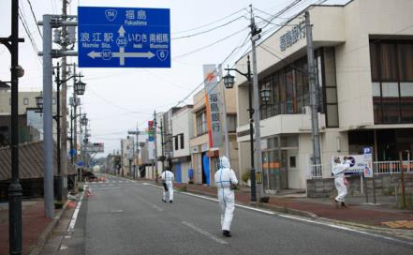
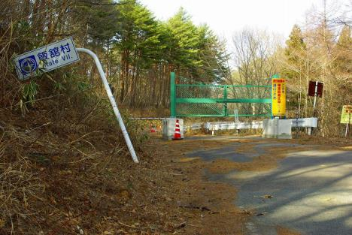
A Place-name Requiem
浪江町Namie, 双葉町Futaba, 大熊町Okuma, 富岡町Tomioka, 飯舘村Iitate, 葛尾村Katsuo

Slide 4
Place-names signify the continuity of communities. They evoke intimacy, nostalgia, personal history and identity.

Slide 5
PURPOSE
Toponyms are the traditional domain of
local history
cultural geography
dialectology
Toponyms: a semiotic resource
Toponyms: important for multilingualism.

Slide 6
Introduction: TOPONYMS and MEANING
TOPONYMS in EVERYDAY LIFE
PLACE NAMES in MULTILINGUAL JAPAN

Slide 7
TOPONYMS and MEANING
- Denotation - Connotation – Metonomy -

Slide 8
Iizuka 飯塚

Slide 10
Iizuka 飯塚 (飯meal, 塚mound)
From a myth concerning Empress Jingu Kogo (神宮皇后) 201-269 (legendary). Parting forever with her faithful soldiers, she hoped、 someday (いつか), to see them again. Thus, Itsuka いつか.

Slide 11
A place-name is a complex linguistic signature, an exquisite reflection of society and culture.

Slide 12
Colemines, shutdown, political radicalism, Yayoi excavations, Aso Taro, town amalgamation and toponym disappearance (３月２６日, 2006） Iizuka absorbed 5 towns and villages in the Kaho 嘉穂郡 district, film locations (e.g. おとし穴 Otoshiana by Hiroshi Teshigahara)

Slide 13
Toponyms function metonymically 換喩（かんゆ):
“Wall Street” is shorthand for….
“Quai d'Orsay” is used figuratively for…
Kyoto 京都 is associated with…
Nagata-cho永田町 is used for…
Kasumigaseki 霞ヶ関 refers to…
Hiroshima 広島 is metonomy for…

Slide 14
Toponyms are a semiotic – a system of signs that embed meanings. Meanings are constructed by context.

Slide 16
Place names, or ‘toponyms,’ are the most powerful geographical reference system in the world.

Slide 17
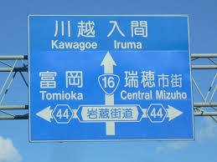

Slide 18
Linguistic DNA
Sometimes, the (only ) vestige of former inhabitants
and social upheavals…contains important, non- archaeological evidence of human life. In this sense, place-names are a linguistic DNA.
★狛江Komae (Japan)
★Methlan – Mediolanum – Milano (Italy)
★Noboribetsu ・・・affixes like -pet (river) in Hokkaido
and some -be endings in Honshū (Japan)
★Pit- Pitlochry or Norse, Vik – Lerwick (Scotland)

Slide 19
Each person has a relation to place. Who we are is linked to where we are.
The connections are complex. They change as life changes.

Slide 20
Place-names signify the continuity of communities. They evoke intimacy, nostalgia, personal history and identity.

Slide 21
LIVING IN A SYMBOLIC LANDSCAPE
Naming is a building block of language. Naming identifies who we are in the world. We are persons with names, naming things in the world. It identifies where we are in the world. Sometimes the personal and the spatial naming coincide in sign (Roland Barthes’ le signe saturé ).

Slide 22
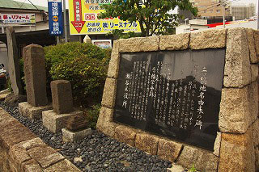

Slide 23
TOPONYMS IN EVERYDAY LIFE

Slide 24
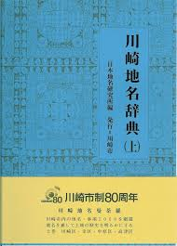
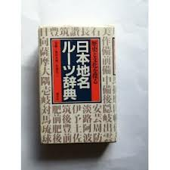
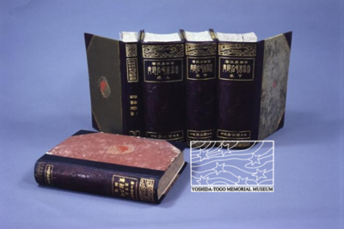

Slide 25
Scholarship began in the 18th century by Hakuseki Arai and Norinaga Motoori (Senda, 1982, p. 171; Sekido, 2000, p. 9).
On the minor toponyms in Japanese villages, Kunio Yanagita (1912), the founder of Japanese folklore studies.
In historical geography, minor place names regarded as important clues in clarifying the past’s landscapes and land indication systems (Kinda, 2010).
Geographers, folklorists have also studied minor place names within Japanese villages: etymology, distribution, vocabulary composition, and resident perceptions (Kagami, 1957; Chiba, 1994; Sekido, 2000; Ueno, 2004)
IMAZATO S., The folk classification system of rural spaces: Reading the landscape as text,Kyoto, Kyoto University Press, 2006.

Slide 26
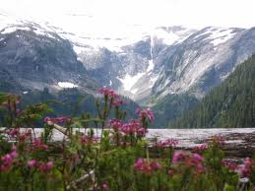
Japan’ is a village along Route 940 Luzerne County, Pennsylvania, USA, west of the borough of ‘Jeddo’ whilst on the opposite side of the continent Mt Manzo Nagano is a mountain in British Columbia named after the first Nikkei immigrant to Canada 永野 万蔵.

Slide 27
PLACE NAMES in MULTILINGUAL JAPAN
In Japan, place-names are an intriguing window on ‘multilingualism’ in Japan since they demonstrate Japan’s demographic and cultural contacts throughout the archipelago and Asia.

Slide 28
JAPAN
A Multilingual landscape
Socio-economic aspects of multilingualism
Bilingualism in vernacular toponomy
Place-names are an everyday affair. Roadsigns.

Slide 29
Ryukyuan
★Many traditional Ryukyuan words appear as prefixes or suffixes such as agari and iri which are equivalent to East (東) and West (西). This occurs in the island name Iriomote (in Yaeyaman, ‘Iriumutii’).
★gusuku- word form: a classic Ryukyuan toponymic
suffix. The etymology of gusuku is unclear. Basil
Chamberlain and Kanazawa Shozaburo segmented it
into gu (< honorific go 御) and shuku (宿) whilst the
latter considered suku a cognate with old Japanese
shiki

Slide 30
THE JAPANIZATION OF RYUKYUAN TOPONYMS
Afagun 阿波根 becomes Ahagon
Agaribaru 東原 Higashibara
Chikazan 津嘉山becomes Tsukazan and Tsukayama
Kabira 川平– Kawahira
Kanagushiku 金城 – Kanagusuku – Kanashiro - Kinjo
Murunzatu 諸見里Moromizato
Nagushiku – 宮城 Miyagusuku

Slide 31
OGASAWARA
bunin (archaic reading of 無人 mujin)
Muko-jima Group (聟島列島 Muko-jima Rettō) - formerly Parry
Muko-jima (聟島, Bridegroom Island);
Yome-jima (嫁島, Bride Island) - formerly Kater Island
Nakōdo-jima or Nakadachi-jima (媒島, Go-between Island)
Kita-no-jima (北ノ島 or 北島, Northern Island)
Mae-jima - formerly the Ears
Chichi-jima Group (父島列島 Chichi-jima Rettō) - formerly Beechey
Chichi-jima(父島, Father Island) - formerly Main I./Peel Island
Ani-jima (兄島, Elrde Brother Island) - formerly Hog I./Buckland I
Otōto-jima (弟島,Younger Brother Island) - formerly North Island Stapleton Island
Mago-jima (孫島 Grandchild Island);
Higashi-jima (東島 East Island)
Nishi-jima(西島West Island) formerly Goat Island
Minami-jima(南島 literally:South Island) - formerly Knorr I.;

Slide 32
- Haha-jima Group (母島列島 Haha-jima Rettō) - formerly Baily or Coffin Islands
Haha-jima(母島 Mother Island) - formerly Hillsborough Island
Mukō-jima (向島 literally: Over There Island) - formerly Plymouth I.;
Hira-jima or Taira-jima (平島, literally: Flat Island)
Ane-jima (姉島, literally: Elder Sister Island) - formerly Perry I.;
Imōto-jima (妹島, literally: Younger Sister Island) - formerly Kelly I.;
Mei-jima (姪島, literally: Niece Island)

Slide 33
Korean
★The community was successively populated by Korean immigrants (Komabito) rendering its place-name from kudara (Eng. Paekche「高麗」 in the south-west of Korea（こま）to 「狛」 or 「巨麻」 to the surrounding area
★Sixth century Korean maps, i.e. the Tara 多羅 river basin, a rice-producing area in Korea. Tradition holds that immigrants from the Tara 多羅 area fled to Pusan following the invasion of Kudara and Shiragi), to Tsushima and then Karatsu. There is also Tara Town
(太良町)

Slide 34
Ainu
AINU PLACE-NAMES IN THE KANTO REGION
Asakusa 浅草 (浅shallow, 草grass)
[Taito-ku 台東区] Short grasses unable to flourish on the sandy soil of the banks of Sumida river 隅田川. From abundant hemp in the area (hemp = asa 麻). From the Ainu, axakusa ‘to go over the sea’. From Tibetian word Aasha kuusha,‘a sacred place’.
Chiba Prefecture千葉県 (千thousand, 葉leaves)
In Nara period, the name was recorded as Chiba-gun (千葉郡). The words Chiba-no-Kudzuno (千葉の葛野) is founded in the document Oninki (応仁紀). Kudzuno indicates the field with Kudzu vine. The area in which the plants “kuzu” grow was conceivably called 千葉 ”Chiba”. In Ainu “chipu-a” a ship or “chipu-pa” many ships in Ainu.

Slide 35
CONCLUSION
Toponyms are the traditional domain of local
history, geography and (etymological) dialectology.
Toponyms: a semiotic resource
Toponyms: signs of multilingualism in Japan

